Slide 1
WELCOME TO MY PRESENTAION Presented By: md.abdullah al mamun refat traininee ID: 9 Batch: is-10 PROGRAM: EDGE COURESE:IT SUPPORT FOR OFFICE MANAGEMENT
SUBMITTED TO:
MD.FAHMIDUR RAHMAN SAKIB
LECTURER AT DEPARTMENT OF
COMPUTER SCIENCE AND ENGINEERING
METROPOLITA UNIVERSITY

Slide 2
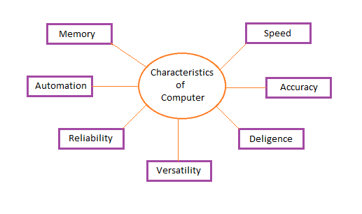
Characteristics of Computer System

Slide 3
Speed
A computer works with much higher speed and accuracy compared to humans while performing mathematical calculations. Computers can process millions (1,000,000) of instructions per second. The time taken by computers for their operations is microseconds and nanoseconds.

Slide 4
Accuracy
Computers perform calculations with 100% accuracy. Errors may occur due to data inconsistency or inaccuracy.
Diligence
A computer can perform millions of tasks or calculations with the same consistency and accuracy. It doesn’t feel any fatigue or lack of concentration. Its memory also makes it superior to that of human beings.
Versatility
Versatility refers to the capability of a computer to perform different kinds of works with same accuracy and efficiency.
Reliability

Slide 5
Memory
A computer has built-in memory called primary memory where it stores data. Secondary storage are removable devices such as CDs, pen drives, etc., which are also used to store data.

Slide 6
THANK YOU

